Slide 1
PLANT DOCTOR
Deloitte TechnoUtsav
3.0
TEST DATA
IIT Bhilai_404 ERROR

Slide 2
ABOUT THE TEST DATA
Test data consists of 63 images.
We used this data to test our model before integrating with other services and telegram.
So, out of 63 test cases, there are 62 pass cases and only one fail case.

Slide 3
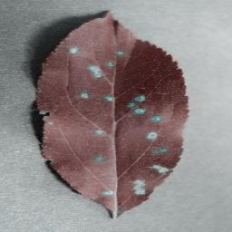
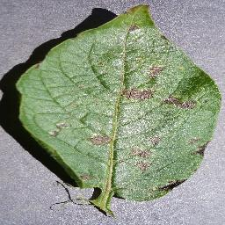
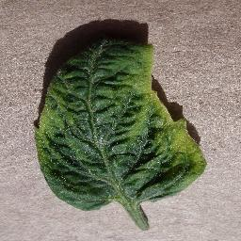
SOME SAMPLE TEST IMAGES AND MODEL OUTPUTS
Apple Cedar Rust
Potato Early Blight
Tomato Yellow Leaf
Curl Virus

Slide 4
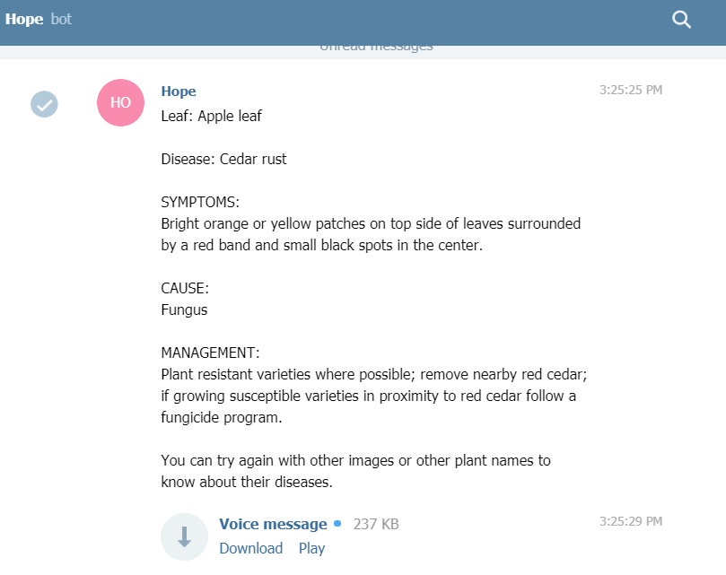
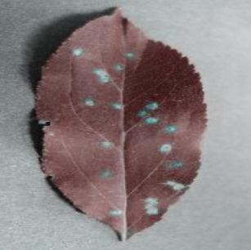
TEST IMAGES AND THEIR FINAL RESULT
USING TELEGRAM
INPUT OUTPUT

Slide 5
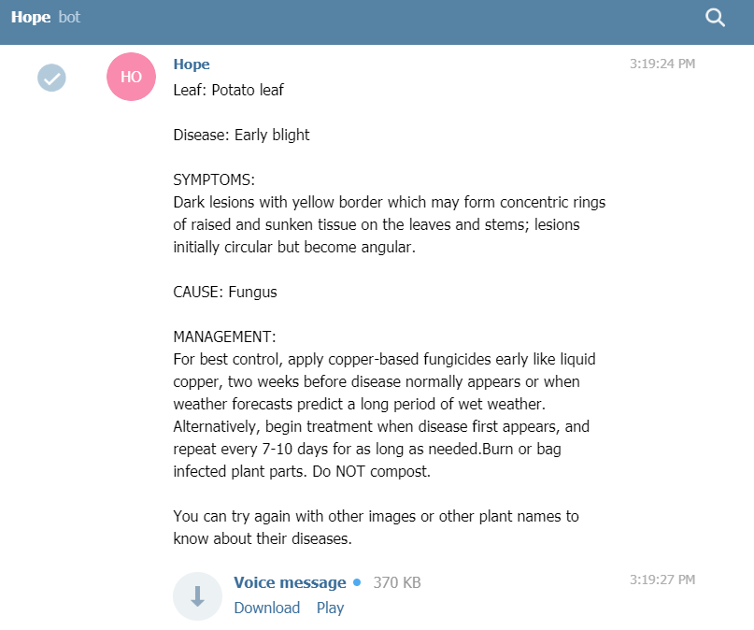
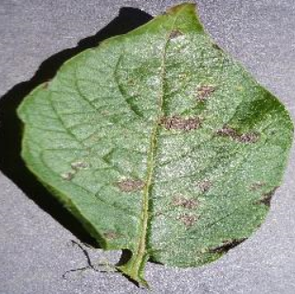
TEST IMAGES AND THEIR FINAL RESULT
USING TELEGRAM
INPUT OUTPUT

Slide 6
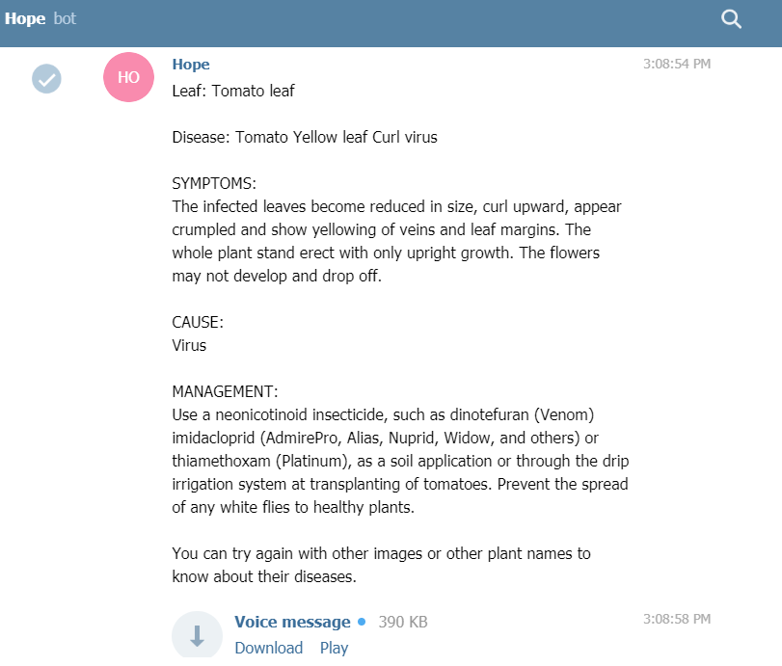
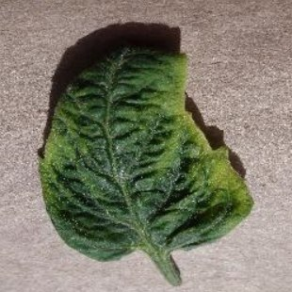
TEST IMAGES AND THEIR FINAL RESULT
USING TELEGRAM
INPUT OUTPUT

Slide 7
Thank you

